Slide 1
Tensor network for machine learning

Slide 2
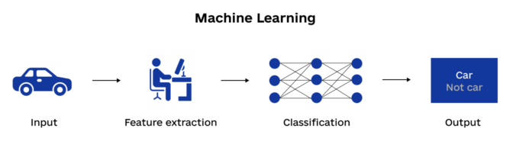
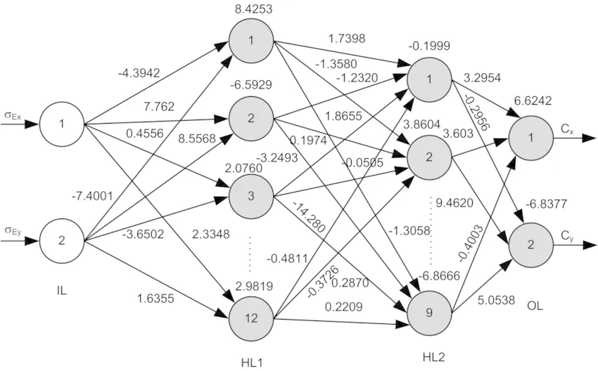
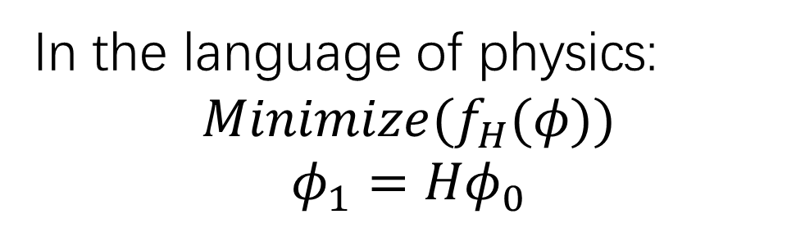
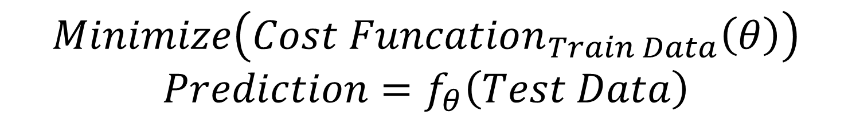
Machine learning in a nutshell
$$Minimize\left(Cost Funcation_{Train Data}\left(θ\right)\right)$$
$$Prediction=f_{θ}\left(Test Data\right)$$
In the language of physics:
$$Minimize(f_{H}(φ))$$
$$φ_{1}={Hφ}_{0}$$

Slide 3
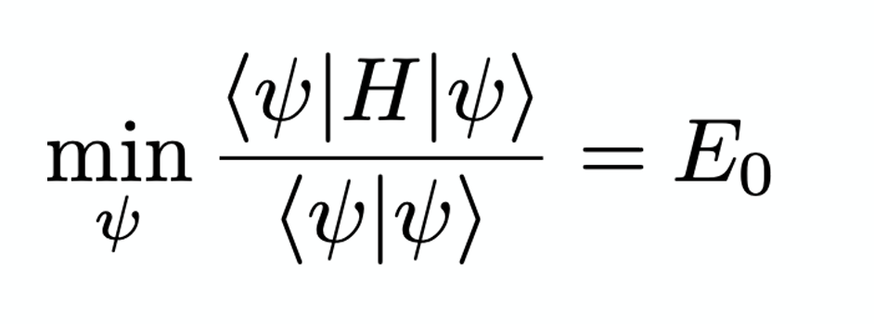
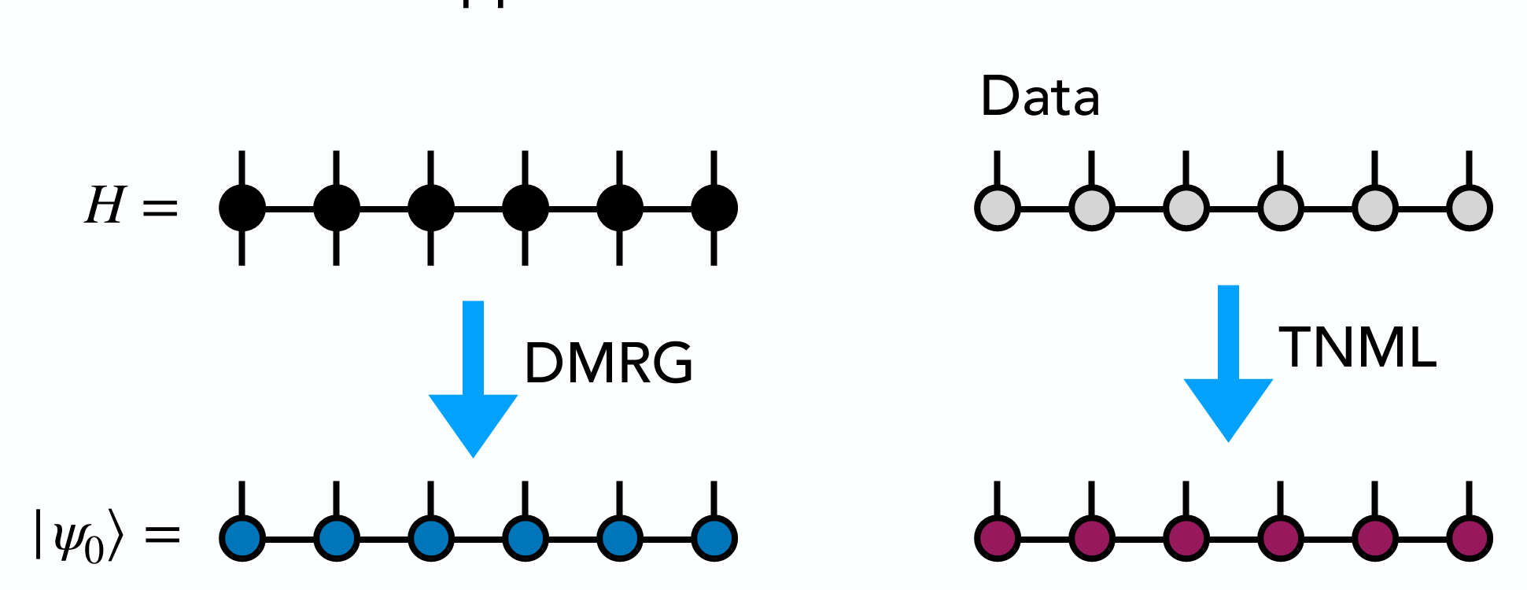
DMRG and optimization
1.We do not change H in DMRG
2. Fully linear

Slide 4
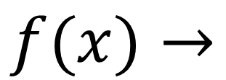
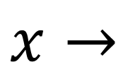
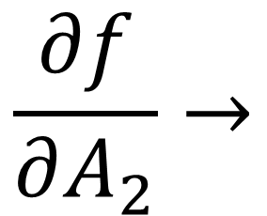
MPS machine learning: we change MPS instead of MPO
$$x→$$
1.Map data to tensor product featured
$$f(x)→$$
2.Apply MPS model
$$\frac{∂f}{∂A_{2}}→$$
3.Optimize MPS Tensor for cost function

Slide 5
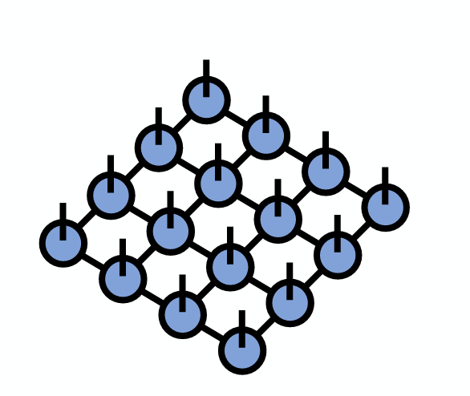
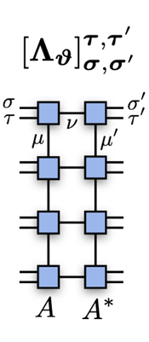
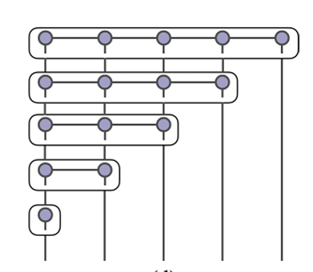
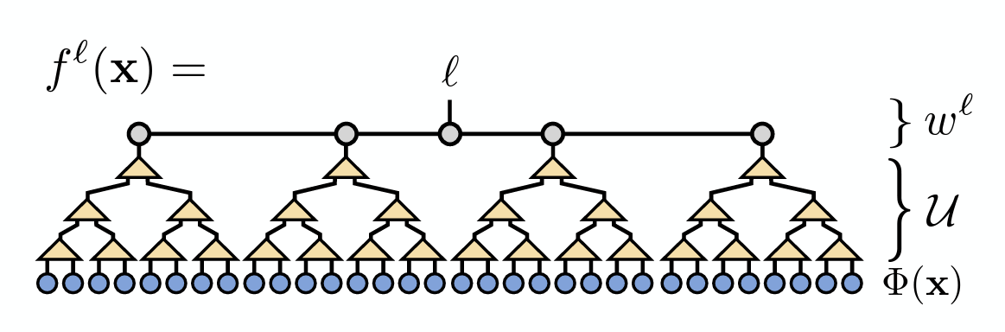
Other tensor network for machine learning
Tensor curtain
MERA

Slide 6
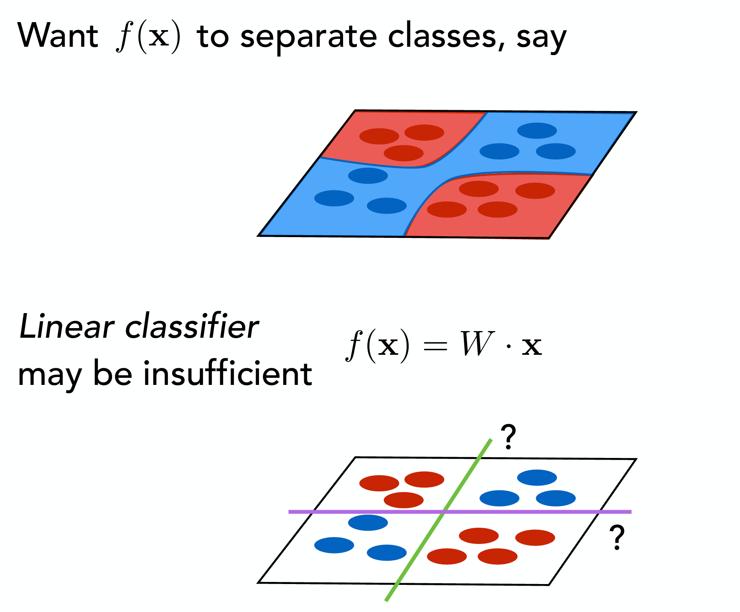
Kernal learning: linear to nonlinear

Slide 7
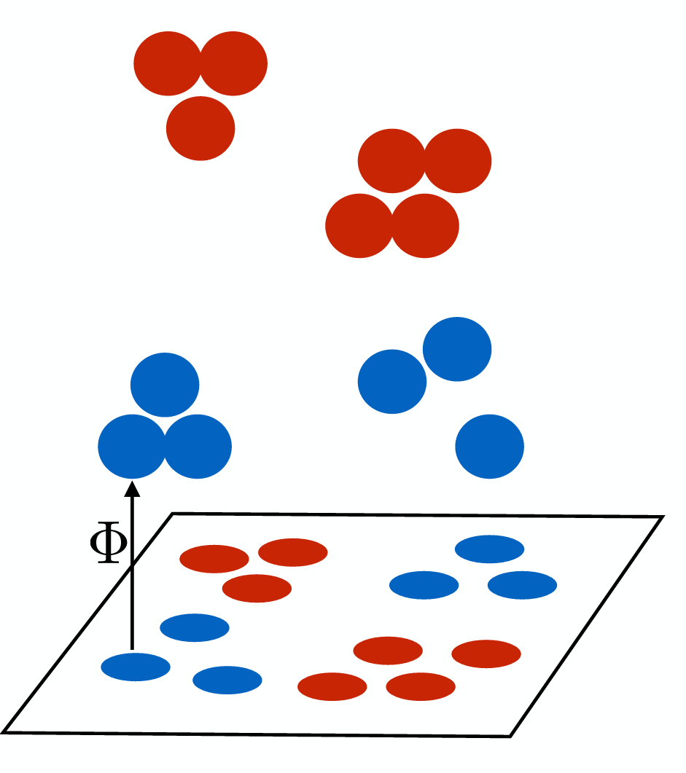
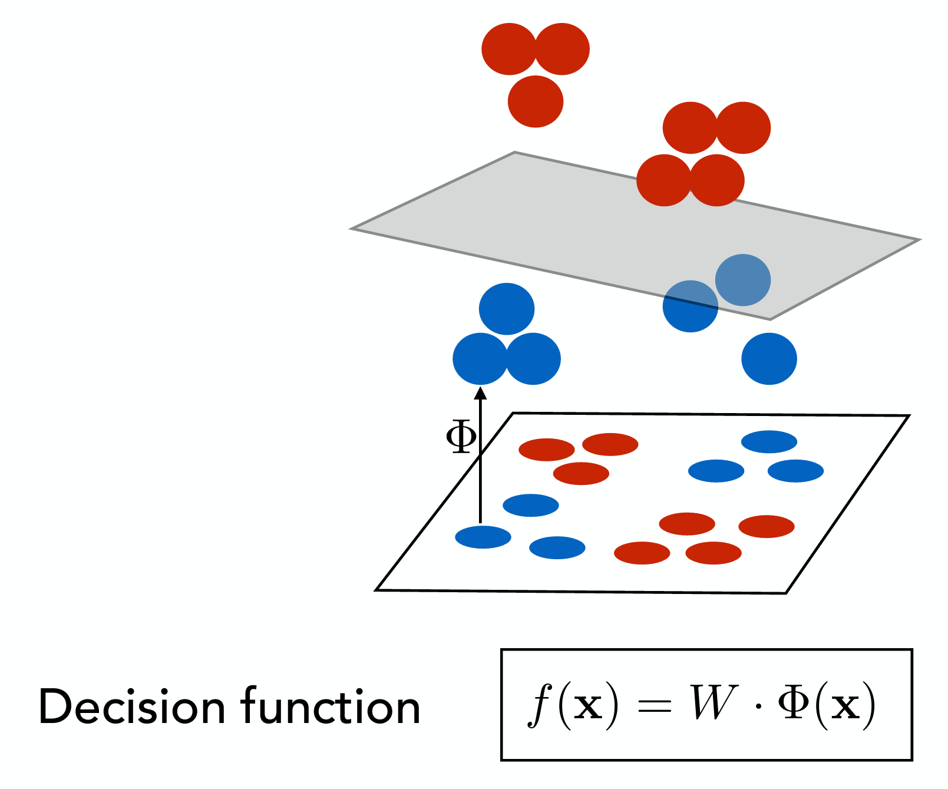
Kernel method: projection to high dimension

Slide 8
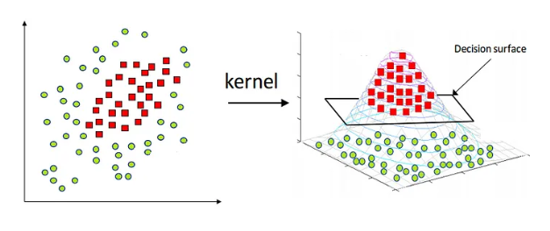
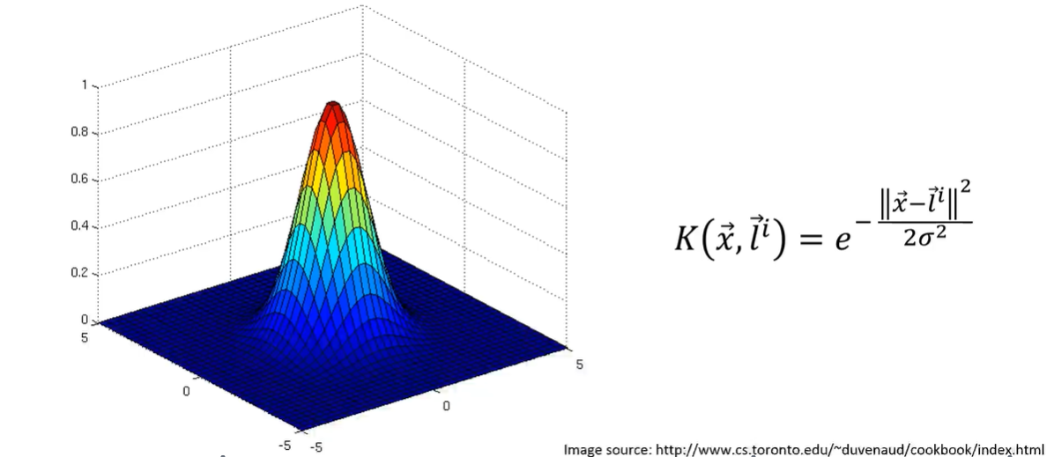
Support vector machine with kernel tricks
Radial basis function kernel(RBK):

Slide 9

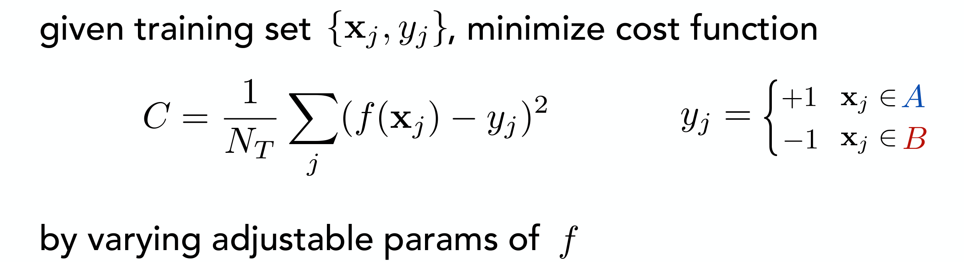
Task: Classification

Slide 10
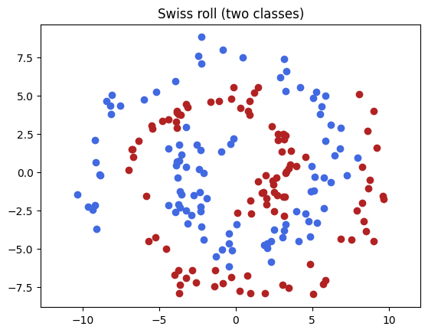
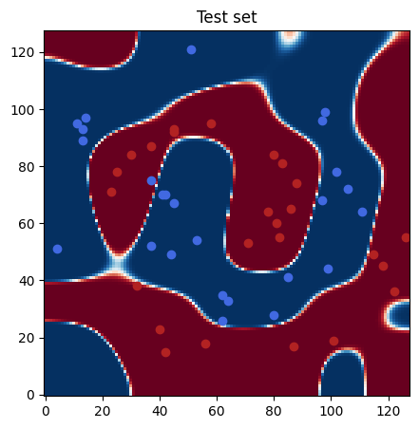
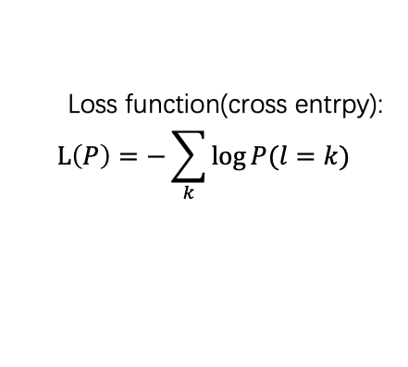
Toy model
Random MPS(Tensor train)
Loss function(cross entrpy):
$$L\left(P\right)=−\sum_{k}{\log{P(l=k)}}$$
75% Training set
10
10
128
128
2
iter
X
Y
L
Trained MPS
10
10
25% test
128
128
2
Trained MPS
10
10
prediction
X
Y
2

Slide 11
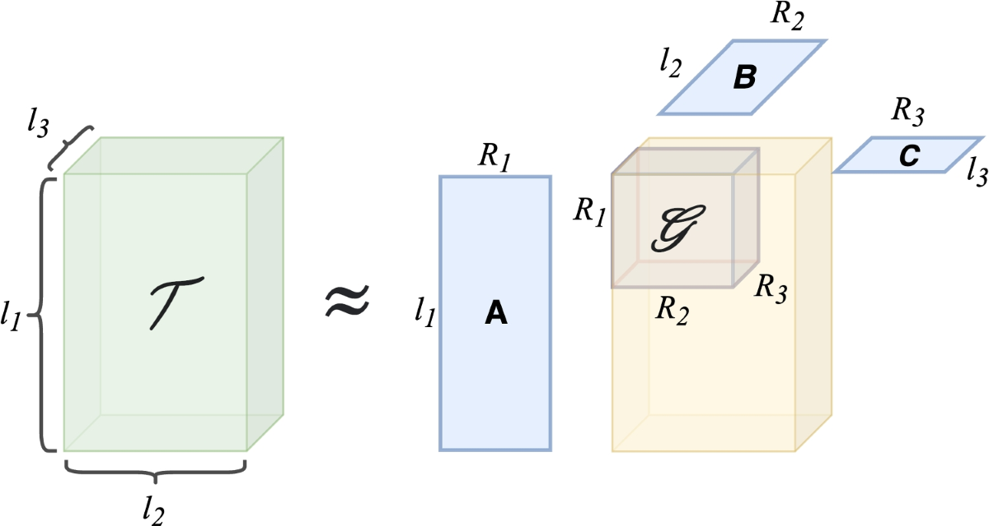
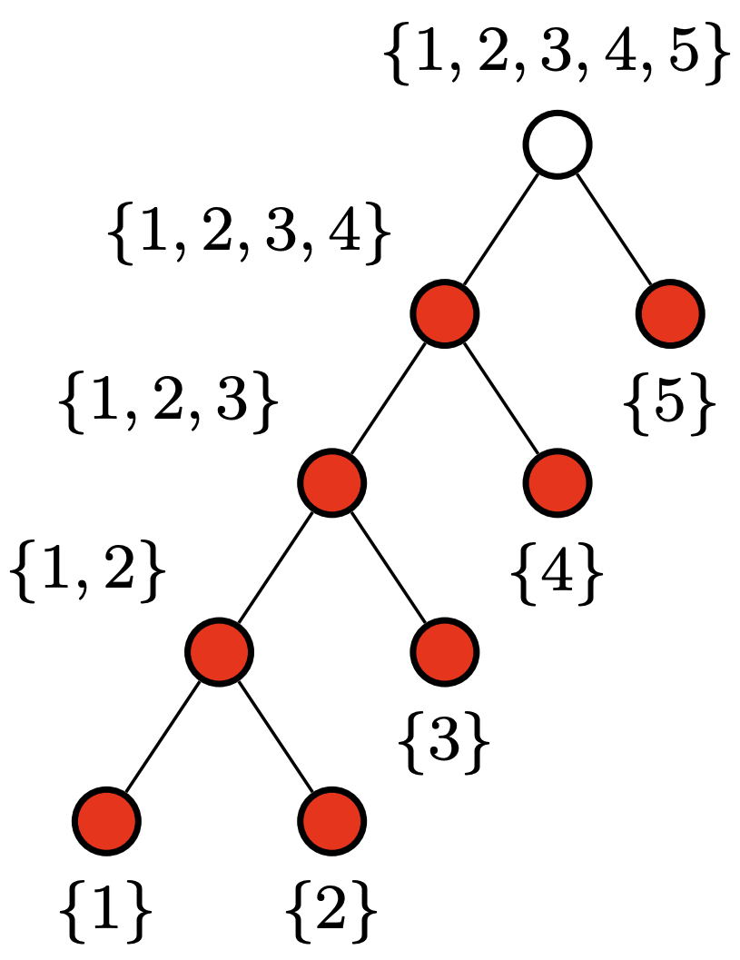
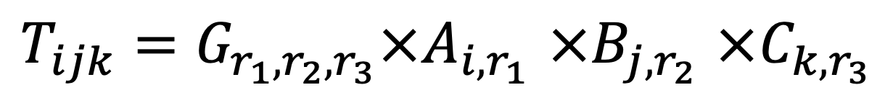
Improvement for TT: Tucker decomposition
$T_{ijk}=G_{r_{1},r_{2},r_{3}}×A_{i{,r}_{1}}$ $×B_{j{,r}_{2}}$ $×C_{k{,r}_{3}}$

Slide 12
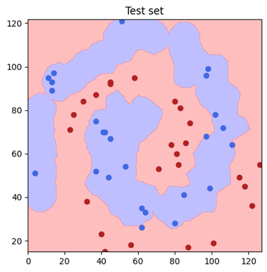
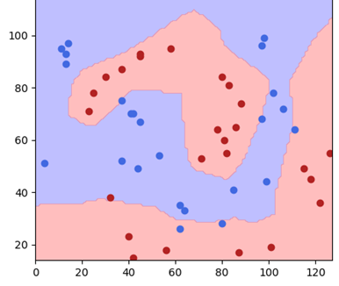
Compare models
Tensor network：
Accuracy：94%
Time:8 s
SVM with RBF kernel：
Accuracy：94%
Time:6 s
Full connected linear NN：
Accuracy：84%
Time:14 s

Slide 13
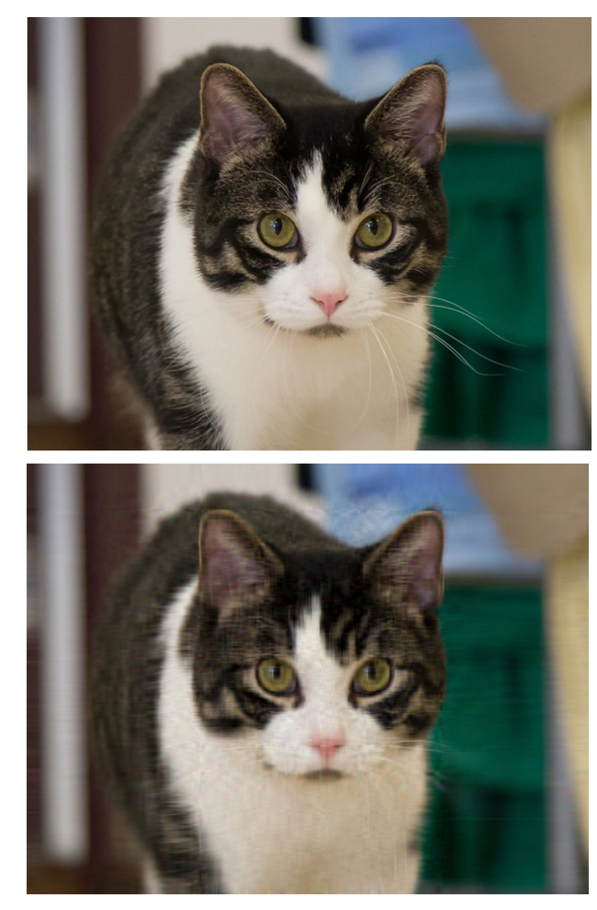

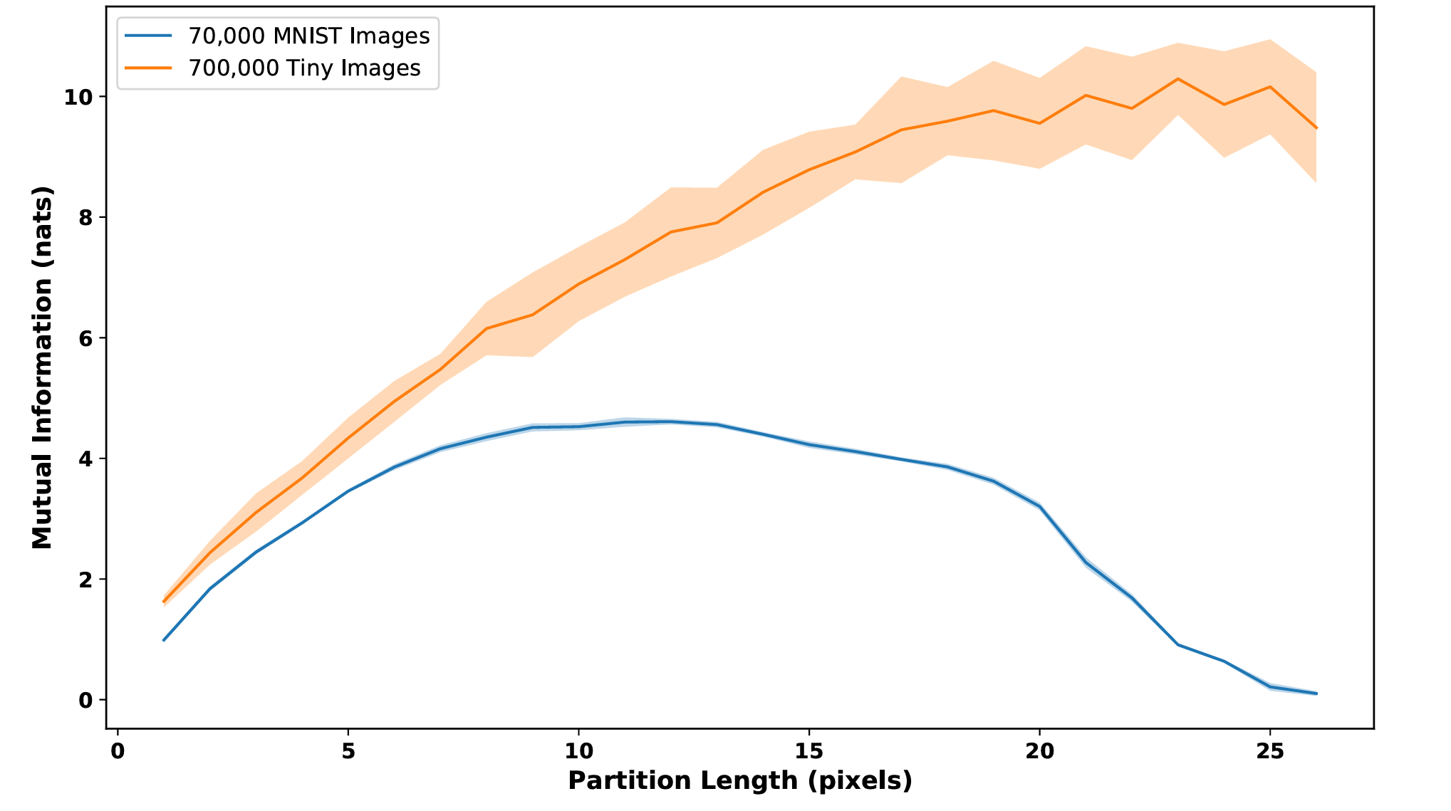
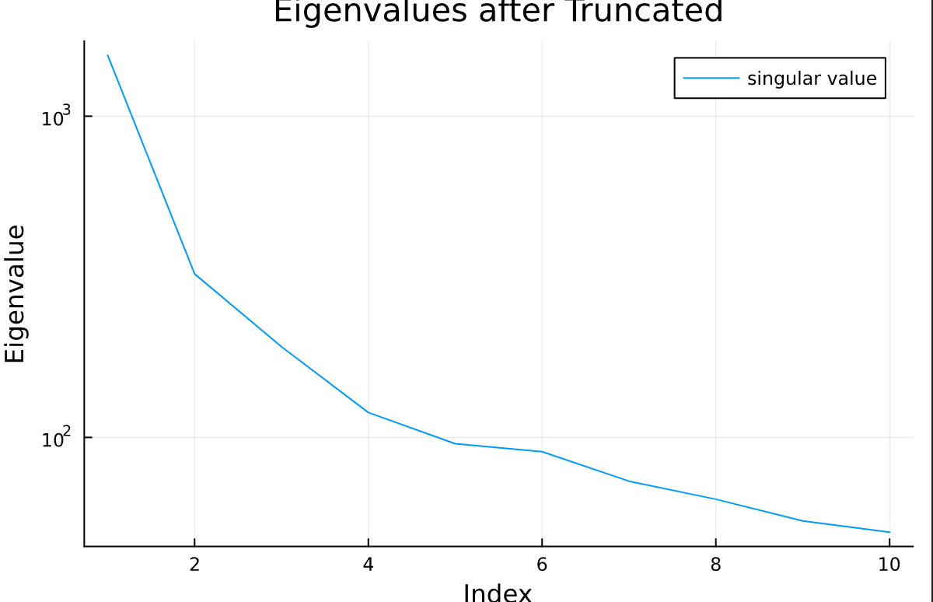
Why TNML works
Most information of an image is pretty localized

Slide 14
Advantage Vs Disadvantage
Pro:
1.Linear complexity compared to kernel learning
2.Explainable linear algebra
3.Easy to handle super high dimensional data
4.Sparse tensor can make TN much effective
Con:
1.TN have lots of parameter, cost to train can be very high
2. Best architecture choices still being explored

Slide 15
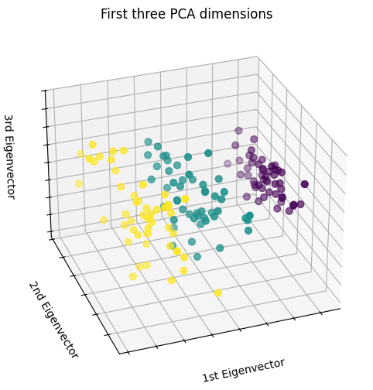
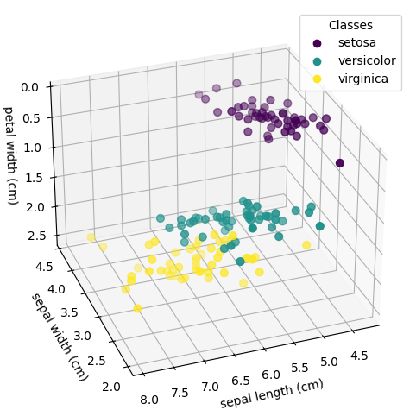
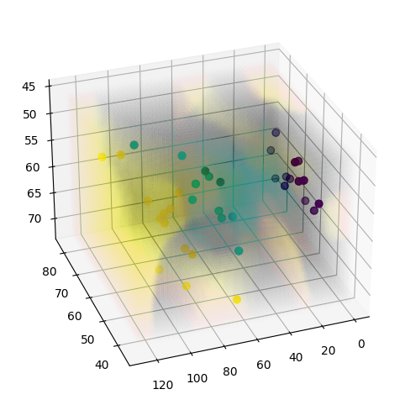
Application1: Iris dataset
Tensor network
Accuracy:
Before PCA: 78%
After PCA: 89%
Time: 14s

Slide 16
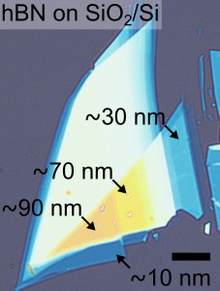
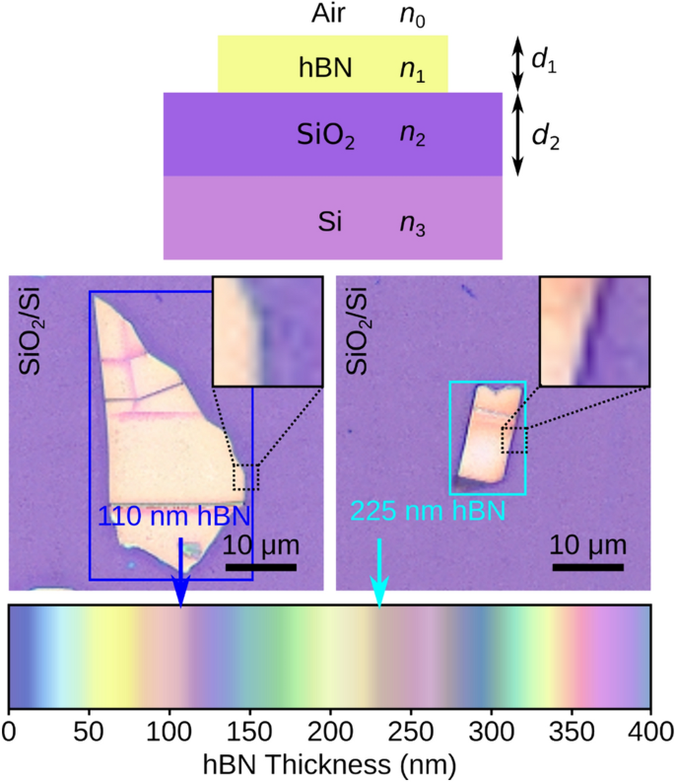
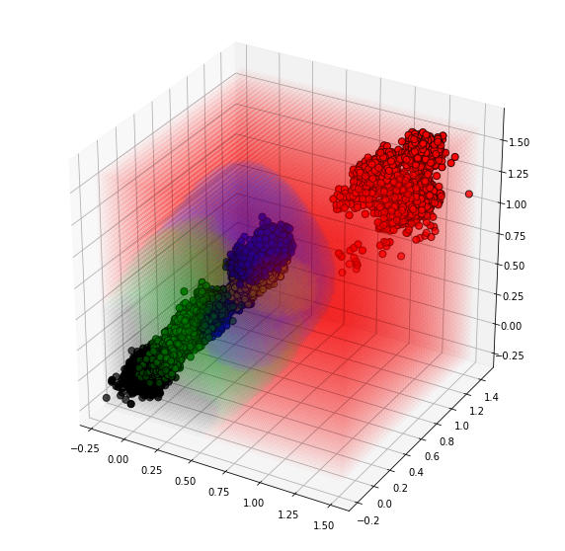
Applicatiton2: hBN thickness
Tensor network
Accuracy: 70%
Time: 40s

